Slide 1


Preparing Your Child for Testing

Slide 2
What are the Florida Standards and Florida Standards Assessment?
The Florida Standards in English Language Arts (ELA) and Mathematics were approved by the Florida State Board of Education (SBOE) in February 2014 and were fully implemented in grades K–12 in the 2014–2015 school year.
All Florida schools teach the Florida Standards. The Florida Standards Assessments (FSA) provide parents and families, teachers, policy makers, and the general public with information regarding how well students are learning the Florida Standards.

Slide 3
How do the Florida Standards benefit my student?
The Florida Standards, adopted by the State Board of Education in February 2014 after unprecedented public input and review, prepare Florida students for success in college, career, and life by emphasizing analytical thinking.
The Florida Standards Assessments provide a more authentic assessment of the Florida Standards, because they include more than multiple-choice questions. Students are asked to create graphs, interact with test content, and write and respond in different ways than required on traditional tests. Question types assess students’ higher-order thinking skills in keeping with the higher expectations of the Florida Standards.
Students, educators, and parents and families are able to preview samples of question types by accessing practice tests that are available in the FSA Portal.

Slide 4
Practice Assessments
Practice tests for all subjects/grades administered.
Can change settings based on student needs.
Paper-based and computer-based practice assessments can be accessed.
www.fsassessments.org

Slide 5
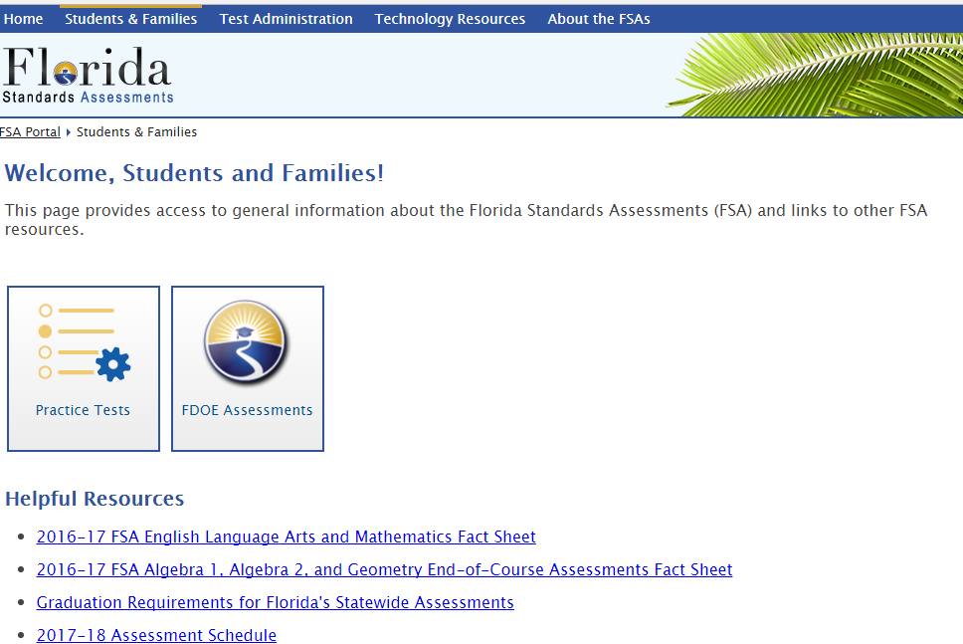
Practice Assessments

Slide 6
3rd Grade Mandatory Retention
Per Florida legislation, to be eligible for 4th Grade promotion students must receive a score of 2 or higher in FSA Reading
3rd Graders who receive a 1 in FSA Reading must show mastery of the Florida Common Core Standards through the Portfolio process or they must attend summer school and receive a passing score on the final assessment

Slide 7
FSA and FCAT 2.0 (Science)
Administration Schedule
3rd Grade:
  ELA (PBT): Tuesday, March 28th &Wednesday, March 29th
  Math (CBT): Monday, April 10th & Tuesday, April 11th
  4th Grade:
  Writing (PBT): Tuesday, February 28th
  ELA (CBT): Monday, April 17th & Tuesday, April 18th
  Math (CBT): Wednesday, April 26th & Thursday, April 27th
  5th Grade:
  Writing (PBT): Tuesday, February 28th
  ELA (CBT): Wednesday, April 12th & Thursday, April 13th
  Math (CBT): Wednesday, April 19th & Thursday, April 20th
  Science (PBT): Monday, May 1st & Tuesday, May 2nd

Slide 8
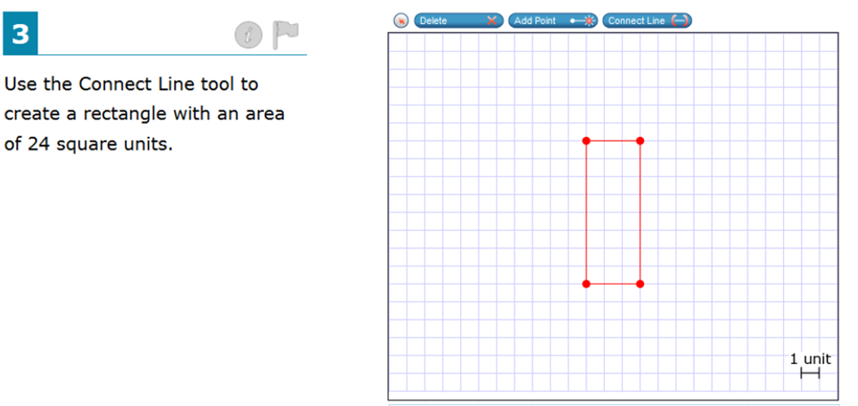
Example Question Math FSA

Slide 9
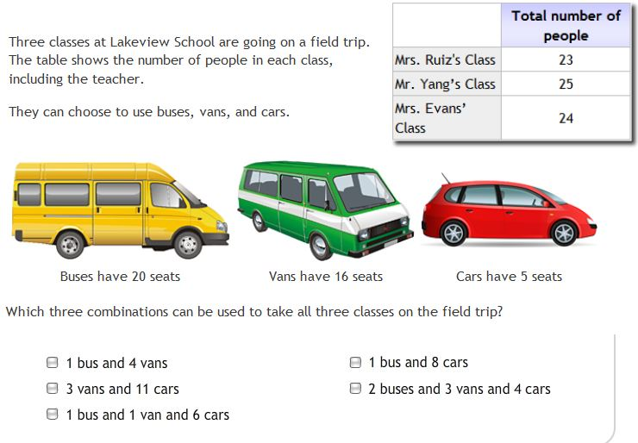
Example Question Math FSA

Slide 10
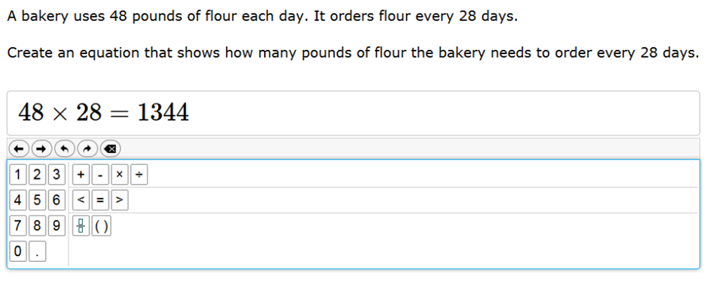
Example Question Math FSA

Slide 11
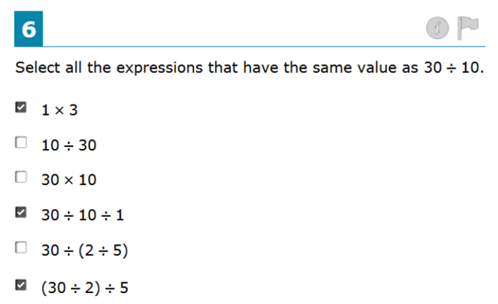
Example Question Math FSA

Slide 12
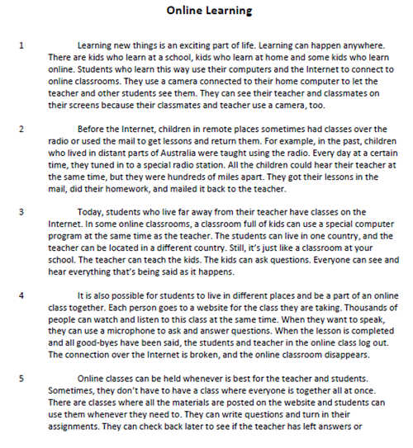
Passage Example English Language Arts FSA

Slide 13
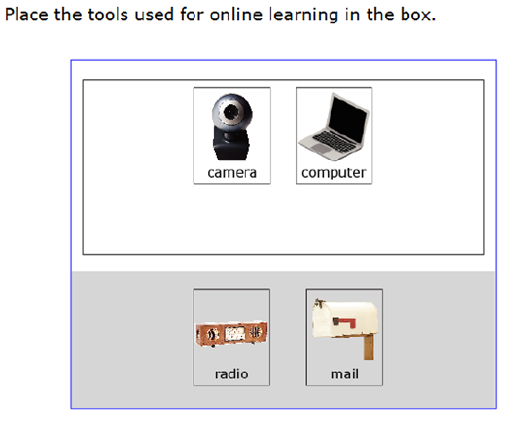
Example for ELA FSA

Slide 14
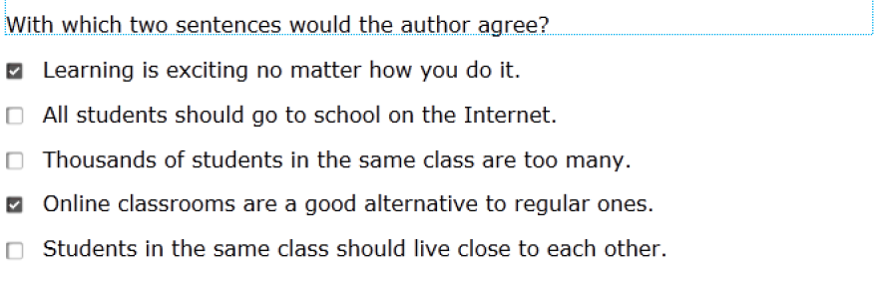
Example Question for ELA FSA

Slide 15
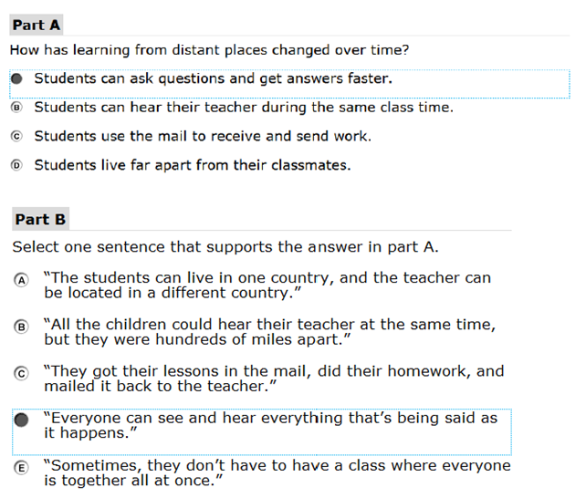
Example Question for ELA FSA

Slide 16
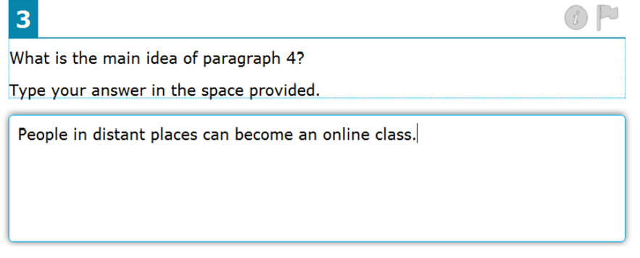
Example Question for ELA FSA

Slide 17
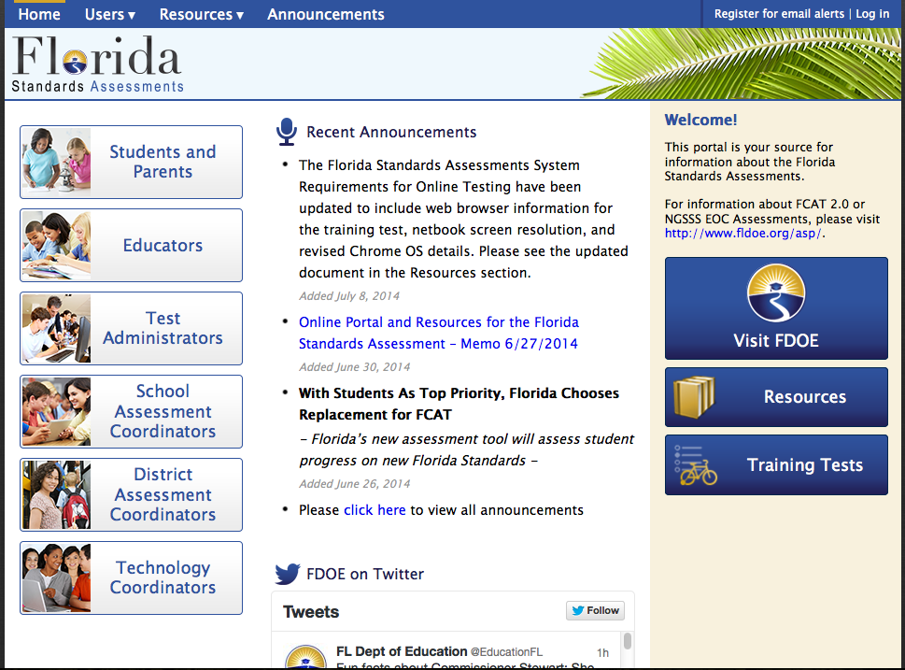
Florida Standards Information Site http://fsassessments.org

Slide 18
How can you help before testing?
Have your child read for focused periods of time to increase reading stamina.
Have your child practice reading “less interesting” materials.
Ask questions about what they have read.
Ask them to make real world connections to the concepts they are learning in school (example: identify the theme of an episode of their favorite television show).
Have them prove/disprove answers.

Slide 19
Reducing Stress
Stress levels depend on individual children.
Make certain you are calm when discussing FSA with students.
Discuss test with kids but keep in mind their personalities.
Depending on your child, it may put them at ease to see the sample assessments online.
Make a game plan on the strategies that he/she is going to use. If they get stressed during the test, how will it be best for he/she to get back on track and calm themselves down?
Help boost confidence beforehand (nightly homework, grades coming home, reading, etc.)!

Slide 20
Reducing Stress
Remind children that their teacher is rooting for them, and we will be there with them.
Debrief with kiddos after the first day. Discuss the “ups and downs” of the test in terms of stress. If necessary, make a new, improved game plan for day two of testing.

Slide 21
The Day of Testing
Make sure they get a good night’s sleep.
Have your child eat a nutritious breakfast.
Aim for a stress-free morning.
Make sure students get to school on time.
Encourage them to do their best and use their strategies.

Slide 22
What OACS Does to Help
Children have been exposed to and interpreting these types of questions since the beginning of the year!
They should be familiar with how to answer the different formats of questions.
We integrate the type of learning with real-world connections on a daily basis that will help lead students to success on these types of assessments.

Slide 23
Question Cards
If you have any questions, please write them on an index card.
Include your child’s name, their homeroom teacher, and an email address.
You will be contacted with answers/additional information.

