Slide 1

Oakland Nature Preserve
Educating, Conserving and Restoring for 20 years
2018-2019 Fiscal Year at a Glance

Slide 2
The Mission:
To promote an understanding of the fragile balance between mankind and the environment by educating visitors about Lake Apopka basin's ecosystems and cultural history, and by restoring and conserving the lands within the Preserve.

Slide 3
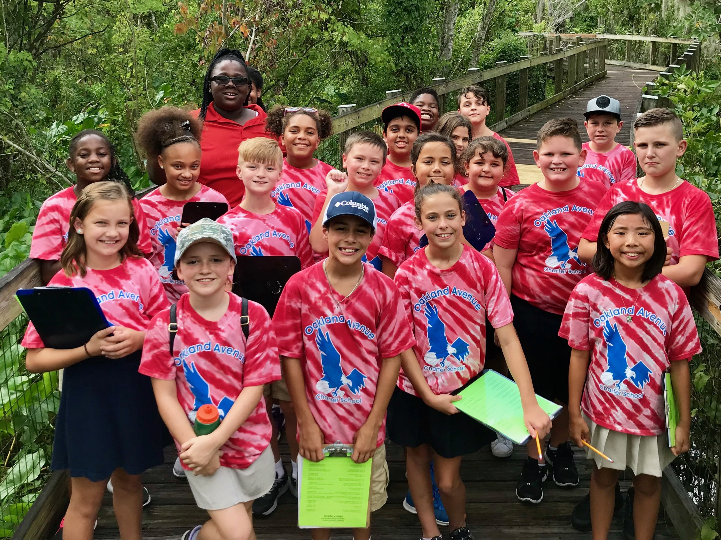
Education
  2236 student days
    52% increase from 2017-2018
      Addition of Montessori 6th grade and 2nd day during week
      Addition of monthly Homeschool series (26 families participated)
      Additional Fieldtrips from local private schools
  Camps
    114 camper days
      Archery Camp, Spring Break Art Camp, Environmental Summer Camps
      Spring Break and Summer Camps filled to capacity
      Have added 5th week of camp for the 2019-2020 fiscal year
  Other Programs (Night Hikes, Blue Hikes, Science Saturdays, Story Time)
    383 participants (these numbers fluctuate based on program offerings)

Slide 4
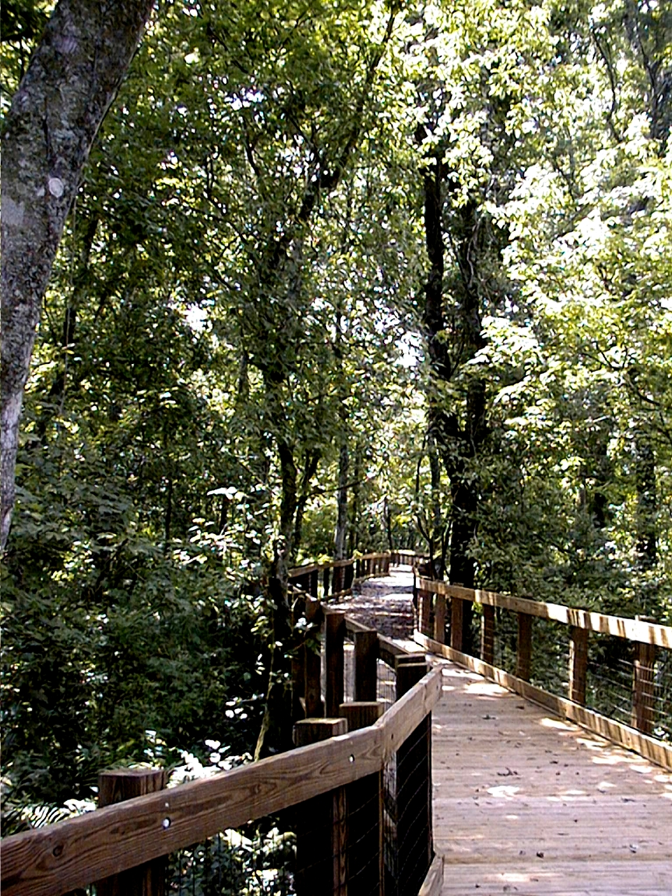
Visitors
Visitors Signed In at ONP
  Boardwalk, porch of EEC, Amon Pavilion
  11,136 sign-ins
  18% increase from last fiscal year
  South America, Asia, Europe, South Pacific
    Majority located us online / Google searches
New Local Visitors
  Facebook
  Programs

Slide 5
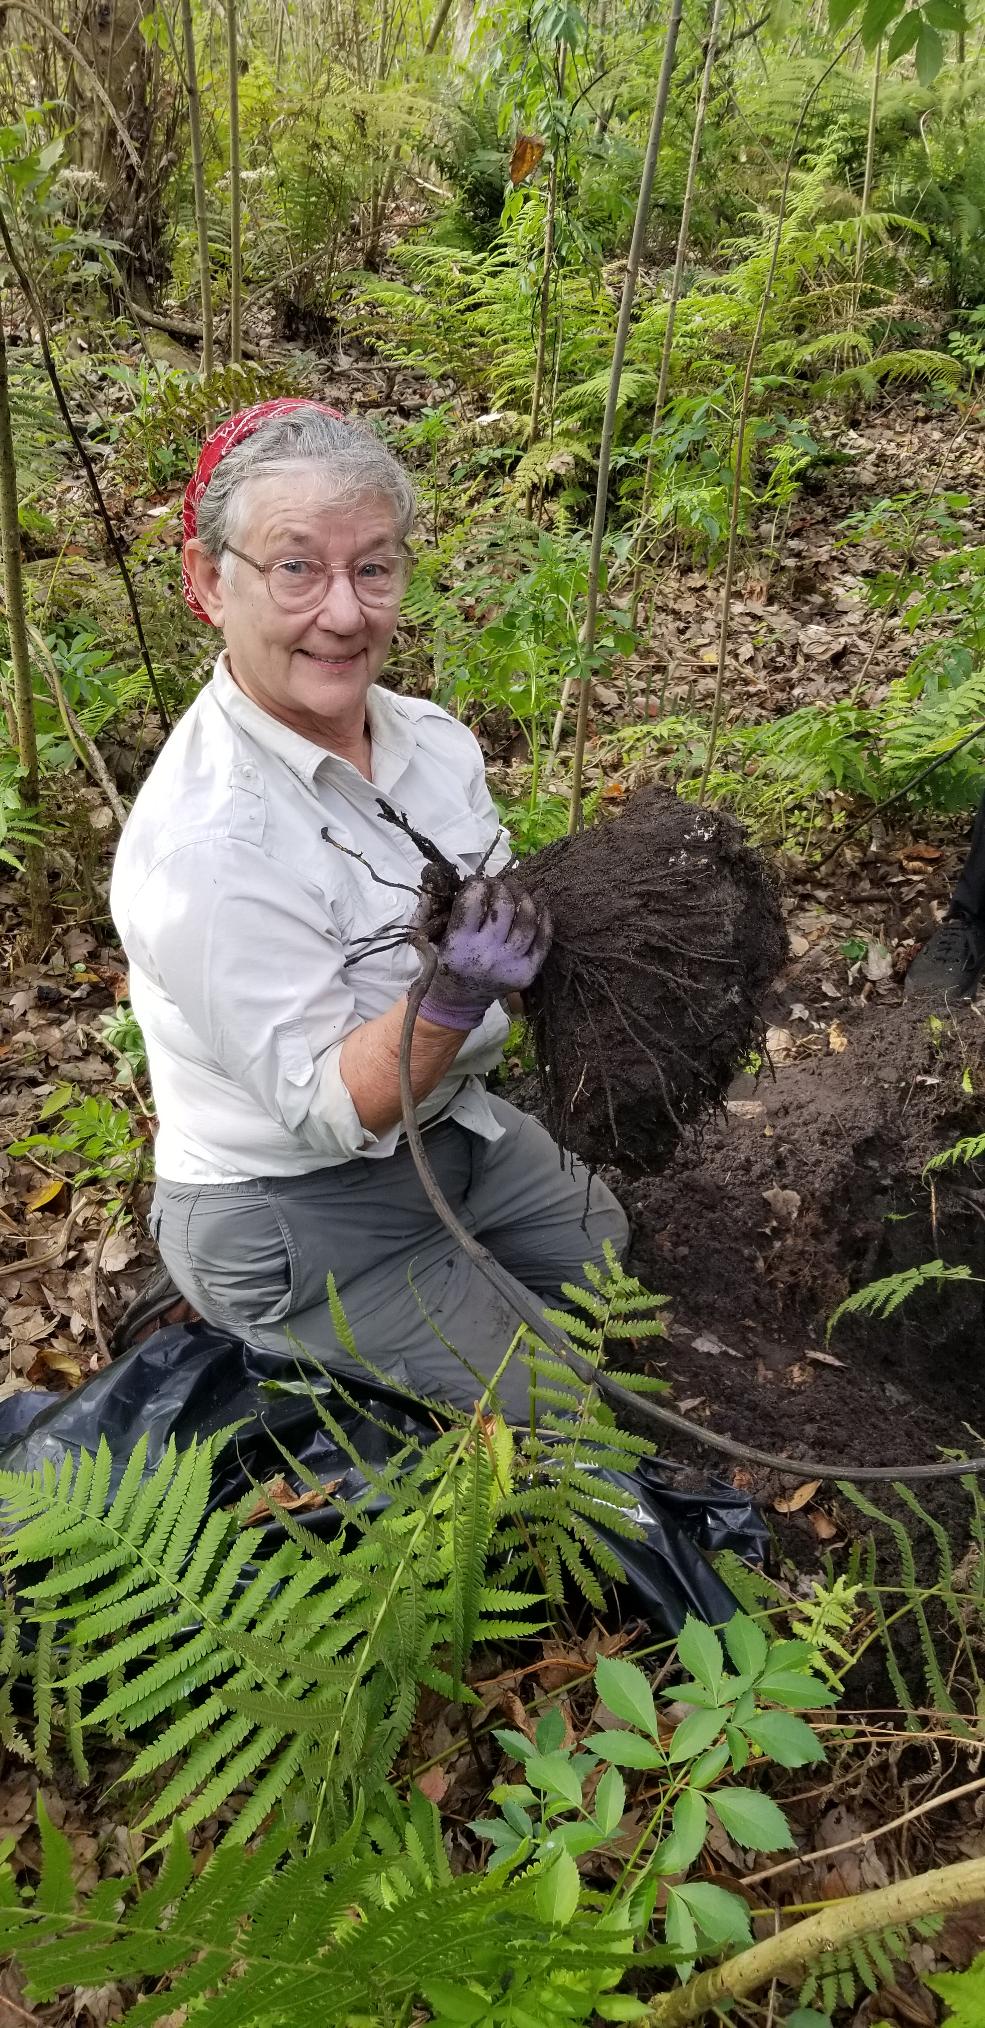
Volunteers
Approx. 6000 hours
  Restoration
  Office and Data Entry
  Corporate Group Participation
Volunteer BOD
Expanded Youth Volunteer Program
  Leaders In Training (age 14-17)
    Camp Assistants
  Eco Interpreters (16-17)
    Porch and Special Event Interpreters

Slide 6
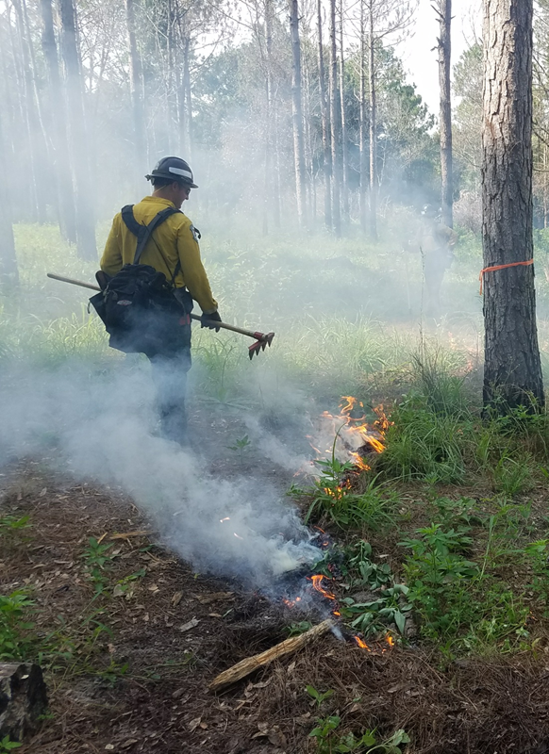
Restoration
Current Restoration Areas
  East (Parking area, Yellow, Blue, Orange, & Purple Trails
  West (Red Trail)
Expanded Restoration Area
  Estimated 2 acres (Area 51)
  Addition of Purple Trail (Eagle Scout Project)
  WDW Conservation Fund Grant
Controlled Burns
  Front acre
  Orange, Yellow, and Purple Trails
Using contractor for chemical maintenance
  Cost covered under the WDW Conservation Grant
  Greatly assisted with work load

Slide 7
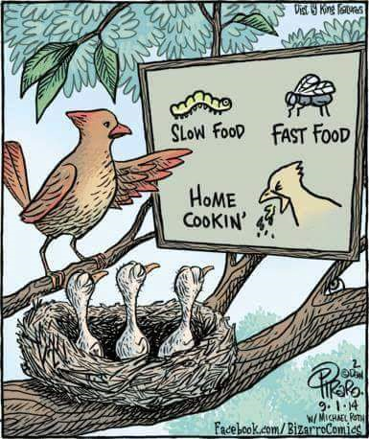
Social Media Presence
Facebook
  3651 followers (39% increase)
  4.9/5 star rating
  Most popular:
    Sunday Funnies 1,000 – 3,000 views/week
    Trail Cam Tuesdays - Trail Camera and Bird Booth album
Instagram
  Small following (862)
  Has not been a focus in the past, starting to ramp it up
Trip Advisor
  4.5/5 star rating

Slide 8
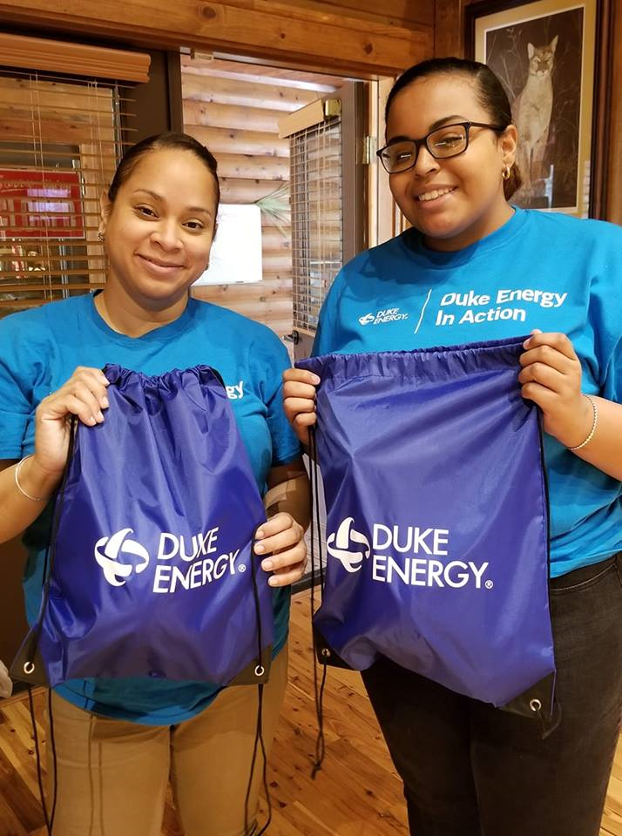
Funding
Current Funding
  Town of Oakland
  Walt Disney World Conservation Fund (Restoration) - $50,000
  Education Matching Grant - $40,000
  Duke Energy (Camp and Blue Hike) - $25,000 + small project funding
  USDA (Upland Restoration 5 year grant) - $25,000
  Orange County Environmental Prot. Div. (General Maintenance) - $15,000
  Private donation (Continues restoration maintenance post WDW) - $15,000
  Several smaller grants ranging from $1,500 - $6,000
  Program fees, fundraisers, donations, memberships
Future Projects
  Florida DEP Trails Grant (Boardwalk Renovations) - $400,000
  Bond Foundation – project has not been determined

Slide 9
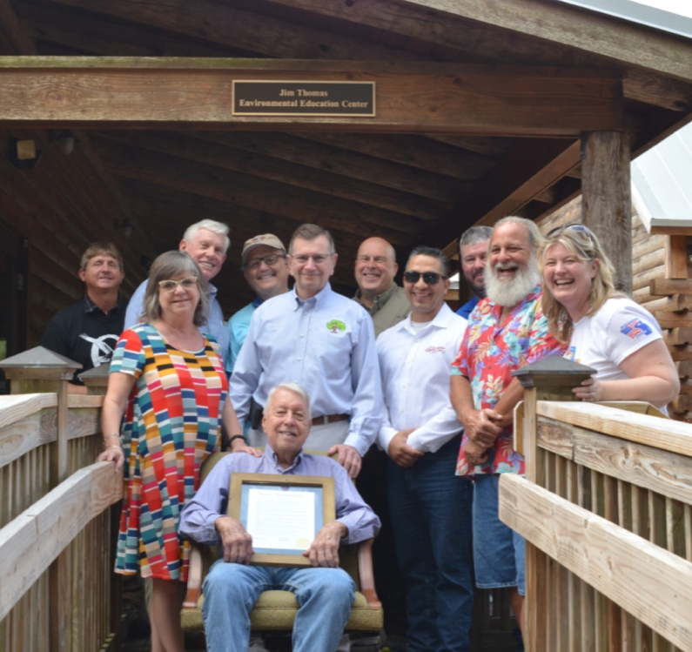
Event Highlights
Oakland Heritage & Wildlife Festival
  Estimated 2,000 visitors
  Approx. $13,000
2019 ONP Open House and EEC naming
  Jim Thomas Environmental Education Center
  Estimated 600+ visitors
  $1,100
Night at the Preserve
  74 participants
  Approx. $4,000

Slide 10
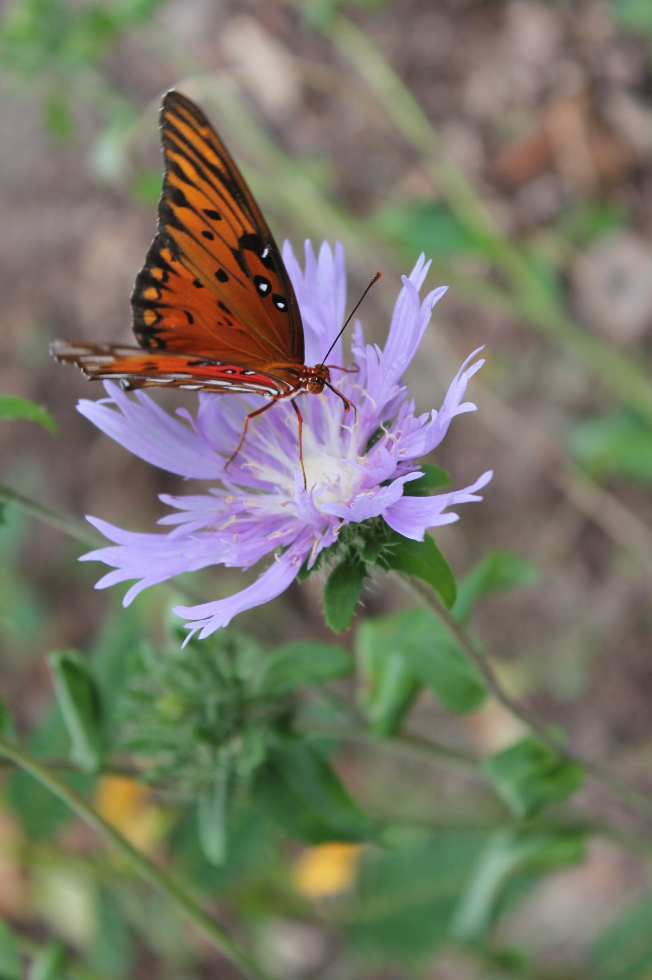
Challenges
Funding for admin salaries
Limited facilities for program requests
  Restrooms, classroom space
Restoration “man power”
  Have implemented a Volunteer Incentive Program
  Continuation of restoration contractor
Grant dependent for many programs
  Adjusting program fees
Marketing
  We hear almost daily from locals “we didn’t know you were here.”
  FB presence has helped

Slide 11
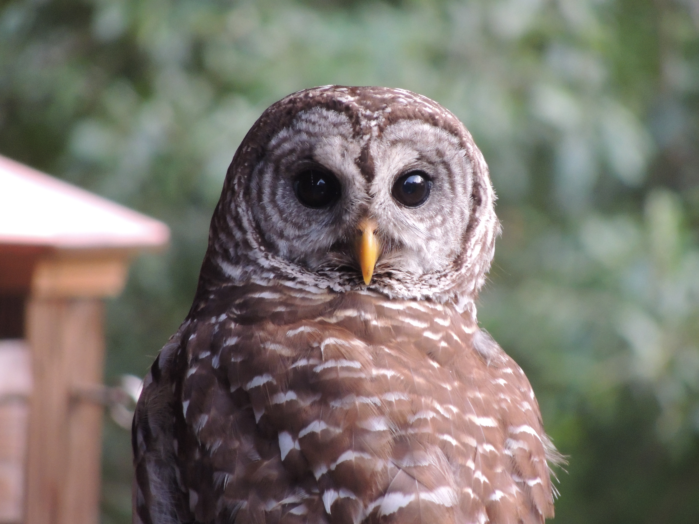
Questions and Comments

